Slide 1
Deeply understand and resonate with people at scale
Restricted

Slide 2
SYMANTO AT A GLANCE
We combine Text AI with Psychology to deeply understand people at scale and leverage into actionable business insights.
TEXT AI
NATURAL LANGUAGE
PROCESSING
PSYCHOLOGY
BUSINESS INTELLIGENCE
ALONG VALUE CHAIN
Notes:
Place image in grey box by Right Click & Format Image. Add text to the lower explanatory pop-up.

Slide 3
WHO WE ARE
We are a software- and service provider around data analytics, combining leading edge Natural Language Processing technology with many years of insights expertise since 2010.
+70 employees
thereof, …
+29
Deep Learning Experts
Psychologists
Data Scientists
AI Engineers
and
Marketing- & Market Research Industry Experts
from 32 nationalities
+80 research papers &
9 PHDs
Germany (HQ)
Spain
Collaboration with professors, researchers in Europe & US
Partnerships with
Germany
Spain
Switzerland
UK
US
 | Monitoring mental health state of German population based on aggregated social media
Notes:
Place image in grey box by Right Click & Format Image. Add text to the lower explanatory pop-up.

Slide 4
INTRODUCING SYMANTO PSYCHOLOGY AI PLATFORM
The next level of Applied NLP by combining unique capabilities that can be delivered in flexible ways.
Deep NLP Engine
Insights Expertise
Psychology & Emotions
Notes:
Place image in grey box by Right Click & Format Image. Add text to the lower explanatory pop-up.

Slide 5
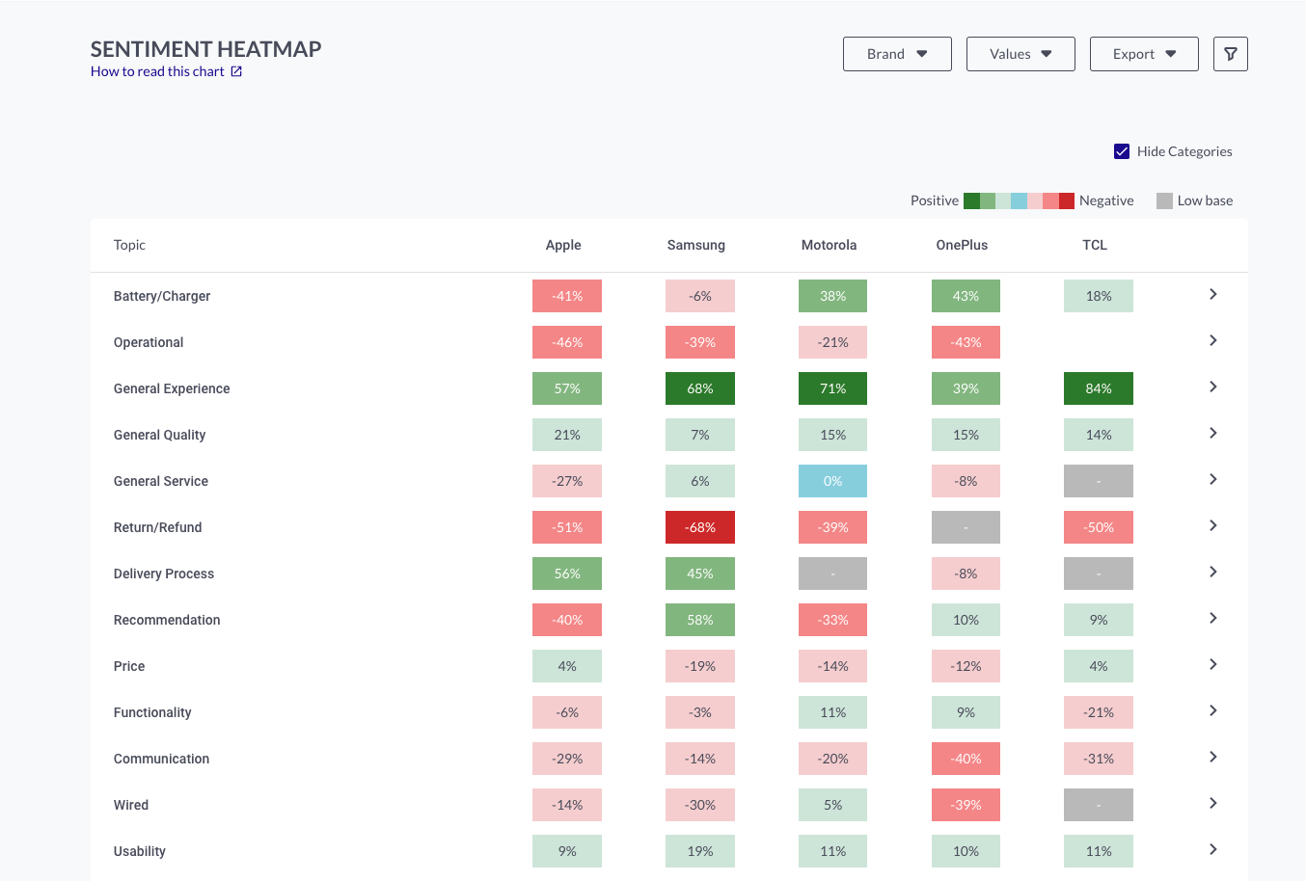
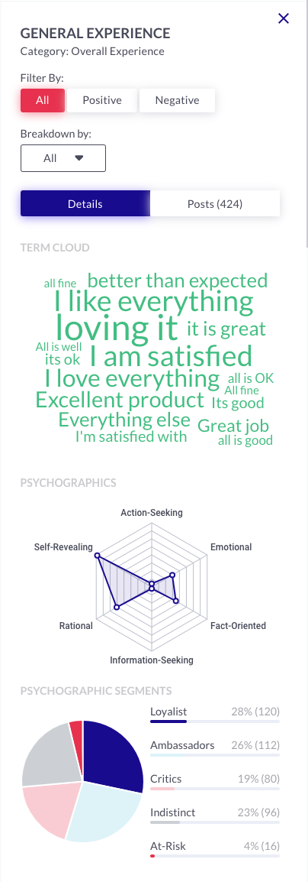
SYMANTO INSIGHTS PLATFORM
A scalable platform that injects various data sources and applies modularised analytics to deliver in-depth insights within minutes.
B2B & B2C
Social media
Review sites
Forums
News sites
Surveys
CRM
Call-Centre transcripts
Chatbots
DATA SOURCES
What do people talk about?
How do people feel about a brand?
What are the emotional and rational drivers of purchasing?
Are consumers recommending a brand to others?
Are people emotionally connected to a brand?
INSIGHTS
Topic Sentiment
Deep Learning Sentiment
Personality Traits
Psychographics
Communication Style
Brand Recommendation
Emotions
Rating Impact Analysis
Open-End Coding
MODULES

Slide 6
SYMANTO INSIGHTS PLATFORM
A scalable platform that injects various data sources and applies modularised analytics to deliver in-depth insights within minutes.
B2B & B2C
Social media
Review sites
Forums
News sites
Surveys
CRM
Call-Centre transcripts
Chatbots
DATA SOURCES
What do people talk about?
How do people feel about a brand?
What are the emotional and rational drivers of purchasing?
Are consumers recommending a brand to others?
Are people emotionally connected to a brand?
INSIGHTS
Topic Sentiment
Deep Learning Sentiment
Personality Traits
Psychographics
Communication Style
Brand Recommendation
Emotions
Rating Impact Analysis
Open-End Coding
MODULES

Slide 7
SYMANTO INSIGHTS PLATFORM
INSIGHTS
DATA SOURCES
What do people talk about?
How do people feel about a brand?
B2B & B2C
Social media
Review sites
Forums
News sites
Surveys
CRM
Call-Centre transcripts
Chatbots
etc.
What are the emotional and rational drivers of purchasing?
Are consumers recommending a brand to others?
Are people emotionally connected to a brand?
MODULES
Deep Learning Sentiment
Topic Sentiment
Personality Traits
Psychographics
Communication Style
Brand Recommendation
Emotions
Rating Impact Analysis
Open End-Coding

Slide 8
SYMANTO INSIGHTS PLATFORM
A scalable platform that injects various data sources and applies modularised analytics to deliver in-depth insights within minutes.
DATA SOURCES
MODULES
INSIGHTS
Deep Learning Sentiment
Topic Sentiment
Personality Traits
Psychographics
Communication Style
Emotions
Rating Impact Analysis
Open End-Coding
Brand Recommendation
B2B & B2C
Social media
Review sites
Forums
News sites
Surveys
CRM
Call-Centre transcripts
Chatbots
etc.
Notes:
Place image in grey box by Right Click & Format Image. Add text to the lower explanatory pop-up.

Slide 9
Symanto Insights Platform
Choose your package according to expected consumption and top up your credits as you go
Discovery Package
Small Package
Medium Package
Large Package
89 €
350 €
1.500 €
3.000 €
To familiarise yourself with our tools
Best for small research studies
Best for small to medium-sized social media studies
Best for brand health or due diligence projects
1.000 collection credits
5.000 collection credits
25.000 collection credits
100.000 collection credits
1.000 analysis credits
5.000 analysis credits
25.000 analysis credits
100.000 analysis credits
Access to all insights modules
Access to all insights modules
Access to all insights modules
Access to all insights modules
Email support and live chat
Email support and live chat
Email support and live chat
Email support and live chat
Personalised training
Personalised training
Personalised training
Personalised training
Credits are valid for one year after purchase. All prices shown are excluding VAT.
Terms of Service apply.

Slide 10
THANK YOU
FOR YOUR INTEREST
Symanto Research GmbH & Co.KG
Hugo-Junkers-Str.13
90411 Nürnberg | Germany
follow us:
sales@symanto.com
“If you really look closely, most overnight successes took a long time.” – Steve Jobs
Symanto transforms textual data from online sources into meaningful insights about audiences, competitors, company valuation, brand equity, mental health and much more. We help you to really understand human motivations, attitudes and emotions and apply this precious knowledge to your daily business through our broad product portfolio. Get in touch with us now and find your perfect solution!
”
Notes:
Place for an image from the presenter in the grey box. Change with Right Click and Change Picture
Insert your name and job title

